Slide 1

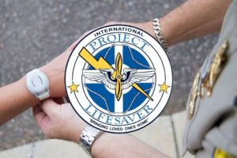
Columbus County Sheriff’s Office
Presents
Project Lifesaver

Slide 2
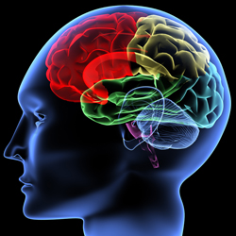
Do you have a loved one who suffers from one of the following cognitive disorders?
Alzhemier’s Disease
Dementia
Autism
Other Cognitive Impairments
If you answered yes, Project Lifesaver can help you protect your loved one.

Slide 3
What is Project Lifesaver?
Project Lifesaver was founded in 1999 in Virginia.
It is a community based non-profit organization designed to protect, and if necessary, locate individuals with cognitive disorders who have wandered away from their caretakers.

Slide 4
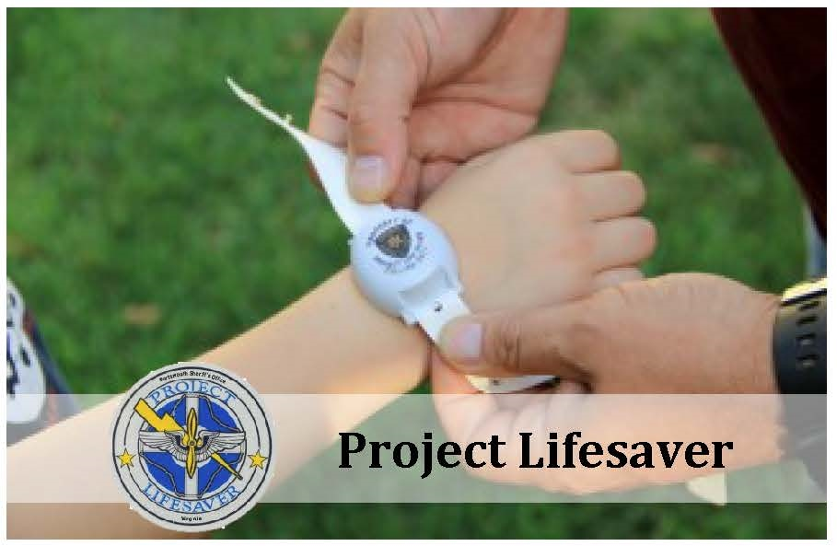
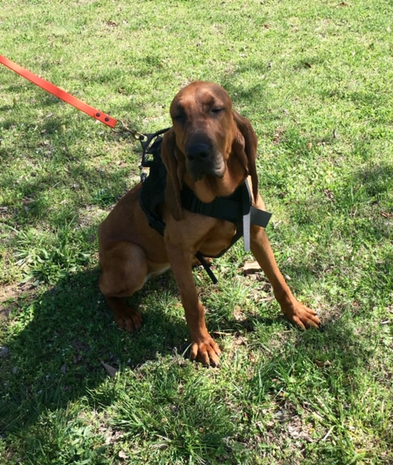
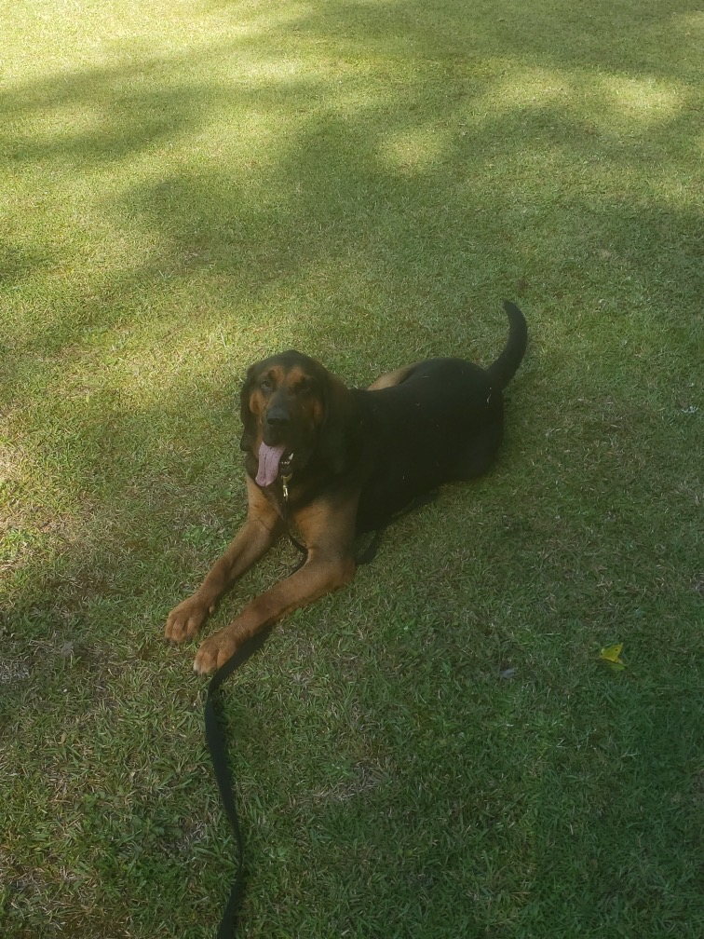
Project Lifesaver is a service provided by Columbus County Sheriff’s Office for Columbus County residents free of charge.
Individuals that have been diagnosed with a cognitive impairment that qualify for
Project Lifesaver, will be fitted with a battery powered transmitter, the size of a watch.
In the unfortunate event that your loved one wanders away from you, specially trained deputies will utilize state of the art locating technologies, along with man tracking K-9s,
to locate your missing loved one.
K-9 Lily
K-9 Law

Slide 5
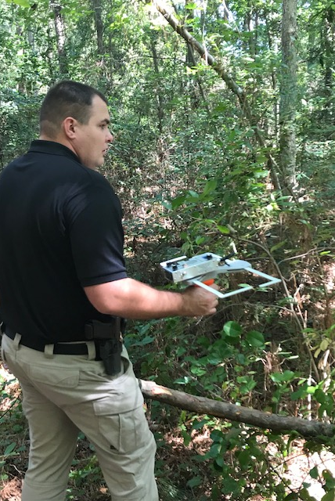
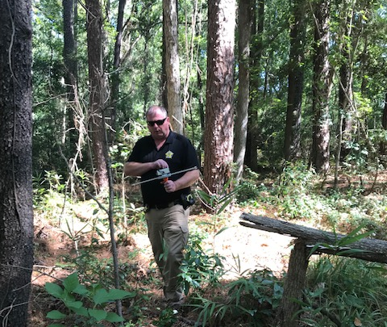
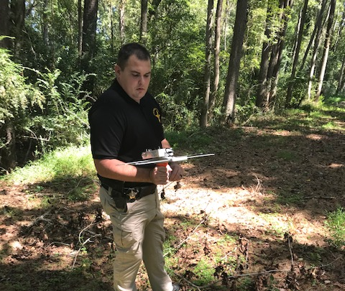
Once an individual is reported missing to Columbus County Sheriff’s Office, a deputy will identify the signal using a specialized receiver, quickly tracking the wandering individual.

Slide 6

Deputies can utilize the tracking equipment on foot, in patrol vehicles, and even by helicopter, to provide the utmost coverage of an area.

Slide 7
Who is eligible for Project Lifesaver?
Must be a resident of Columbus County
Diagnosed with Alzheimer’s Disease, Dementia, Autism, or other cognitive impairments
Receives 24 hour care by a family member, spouse, or other caretaker
Responsible caretaker must be available to inspect equipment daily
No longer able to operate a motor vehicle

Slide 8
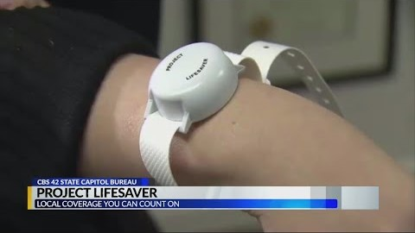
Project Lifesaver Video

